Slide 1
December 2023 release of Power BI apps on telemetry
Dynamics 365 Business Central

Slide 2
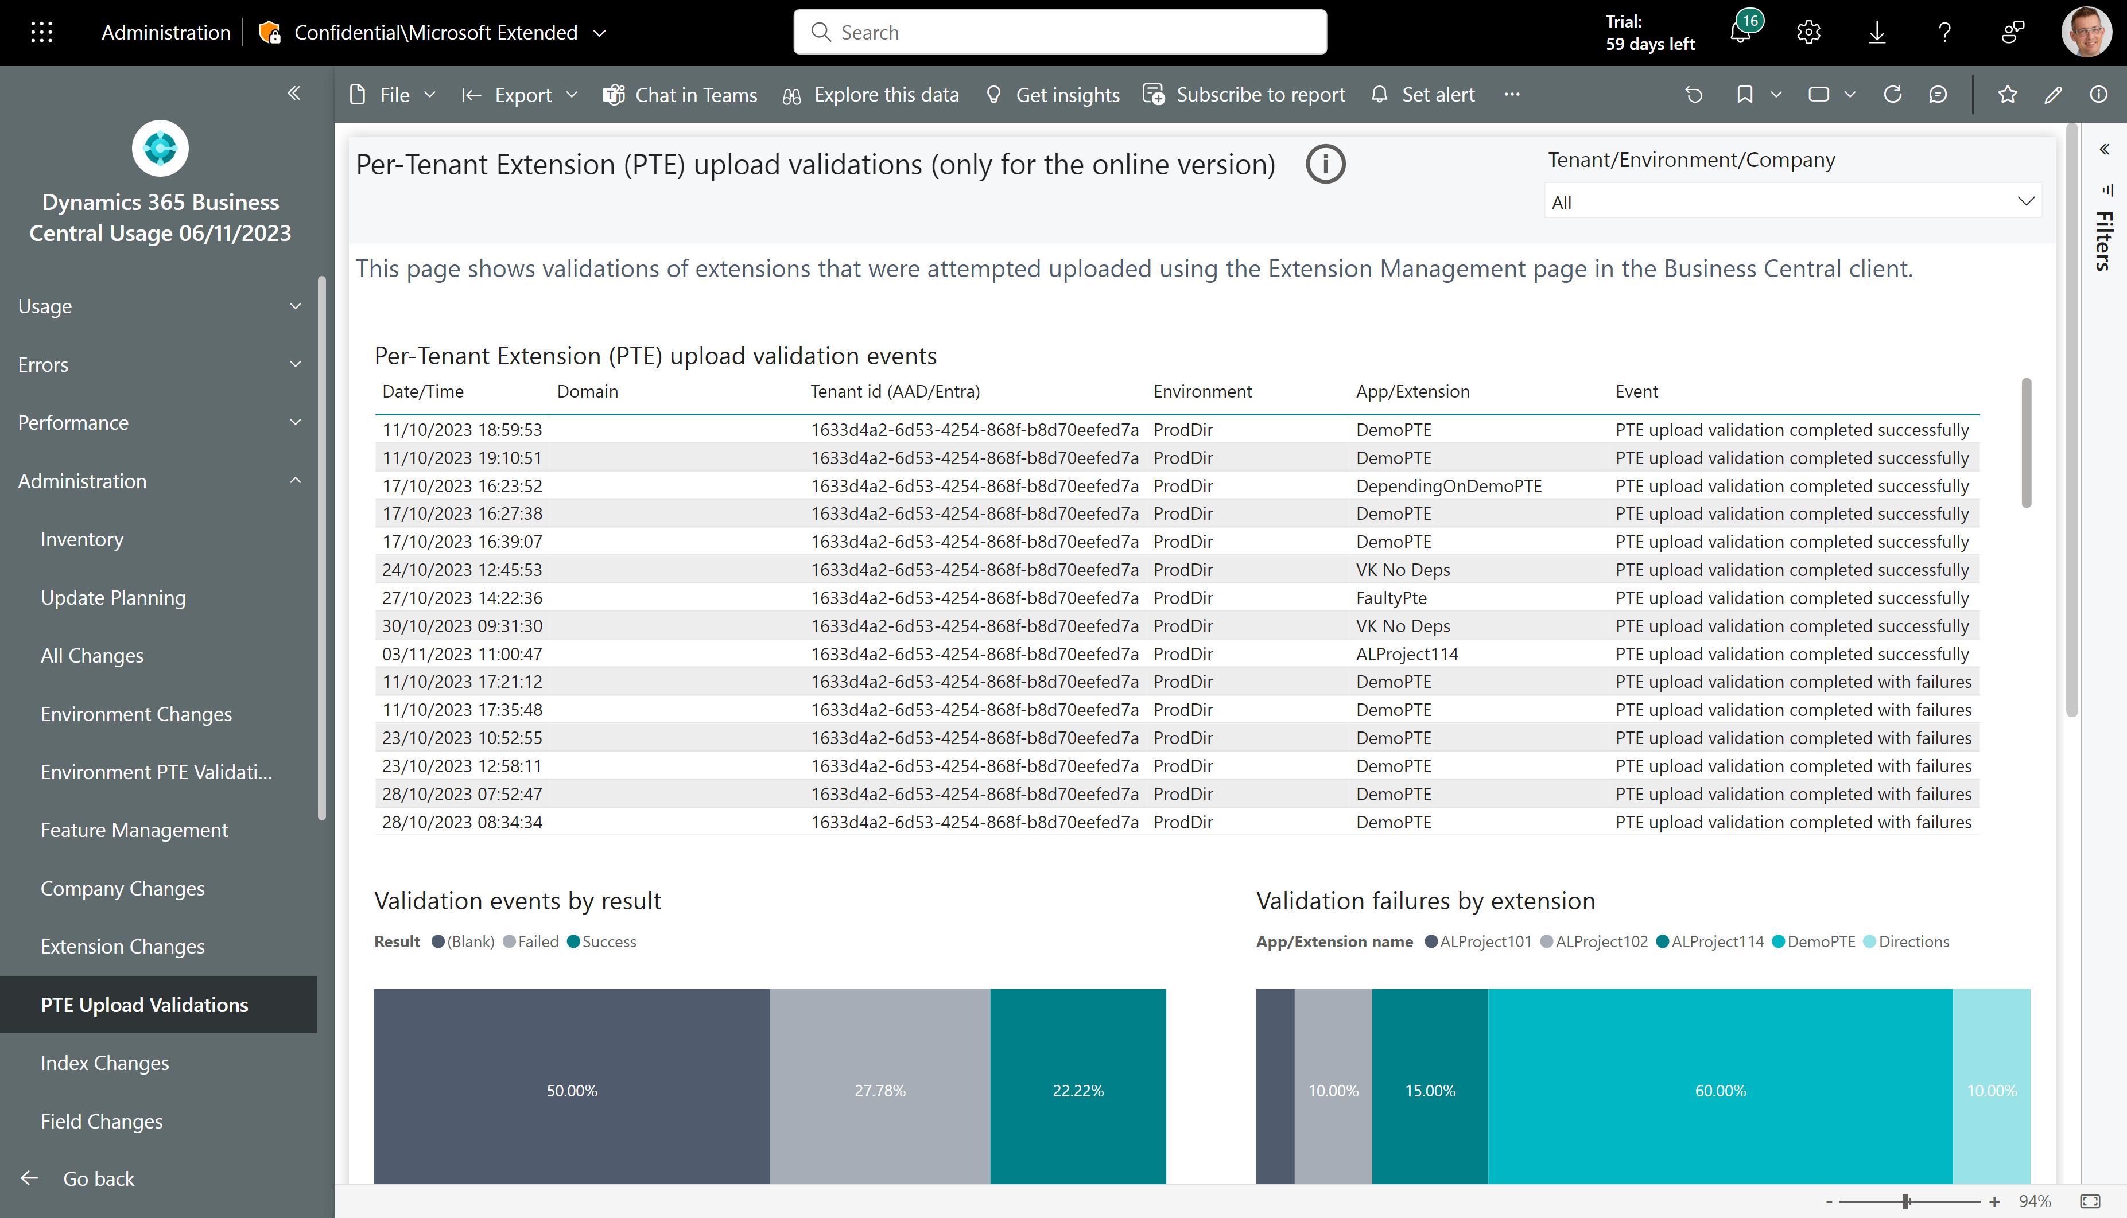
New Administration page: PTE upload validations
See all attempts to upload Per-Tenant Extensions from the Extension Management page

Slide 3
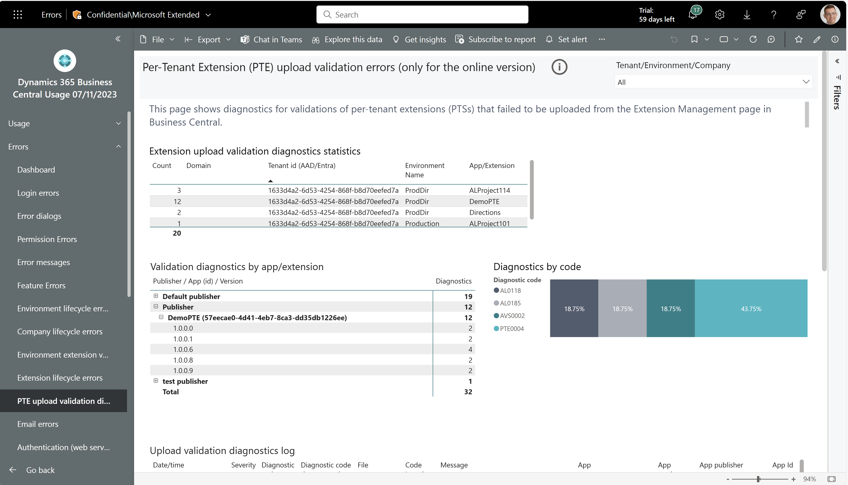
New Error page: PTE upload validation diagnostics
See all diagnostics for failed Per-Tenant Extension (PTE) uploads from the Extension Management page

Slide 4
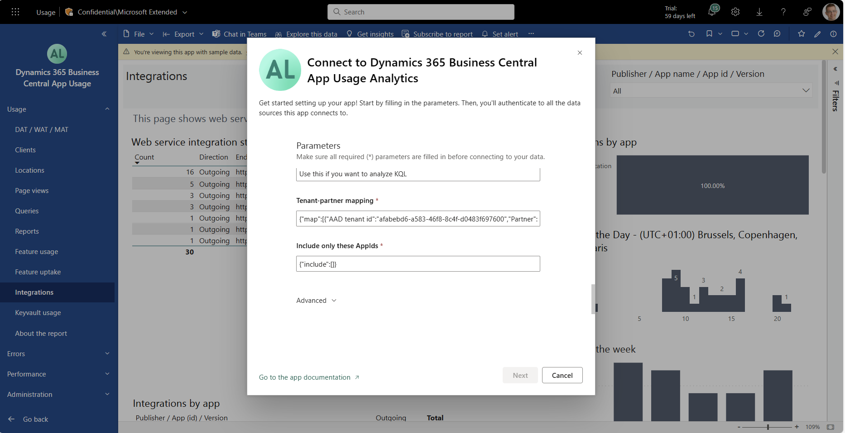
ISV app: now supports filtering to specific apps (in the dataset)
Filter the Power BI dataset to only refresh with data for a list of apps

Slide 5
Get the apps from Appsource
For environment telemetry
https://aka.ms/bctelemetryreport
For app telemetry
https://aka.ms/bctelemetry-isv-app

Slide 6
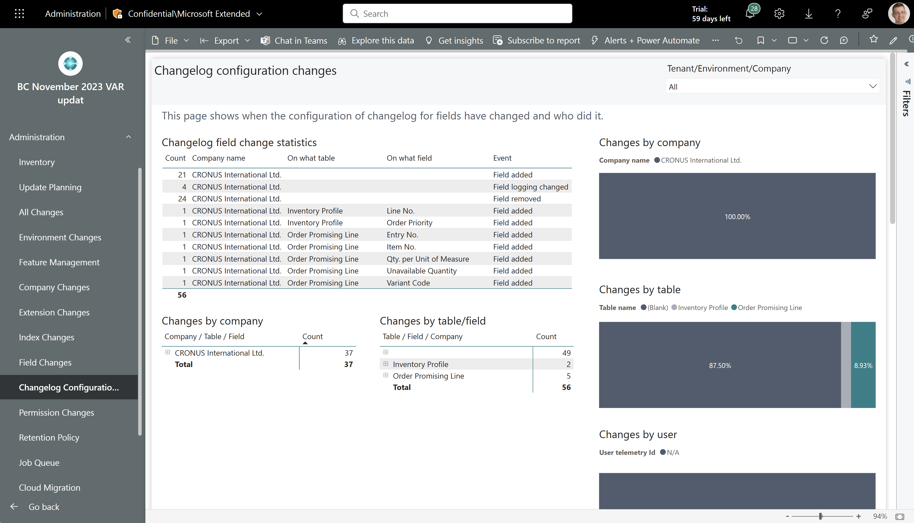
TEMPLATE
See all changes to change log configurations that happened across all customers.

